Slide 1
WELCOME September 8, 2021
California Society
Training Session

Slide 2
Open Forum Dues Campaign and CASSAR Member Reconciliation
California Society
Training Session

Slide 3
2022 Compatriot CASSAR Newsletter
The California Society will not be offering to send out hard copies of the Compatriot to Chapter Members in 2022, because the Compatriot is being issued monthly on line.
Back issues can be read on line.
If there are chapters that have members that wish to have a hard copy, it will be the chapter’s responsibility to print off the newsletter and send to the members: Note the Compatriot does not format well to a printer.

Slide 4
New information on the NSSAR Web Web-site-Yellow Data Base
Death Reports
There is a new format for reporting the death of a chapter member. The report is on the on the Yellow system.
Chapter secretaries must still email information to the CASSAR Secretary, so the CASSAR Roster can be updated and the appropriate state individuals can be notified.
Chapter Secretaries can now change a members address directly with a form found on the CASSAR website-Yellow System.

Slide 6
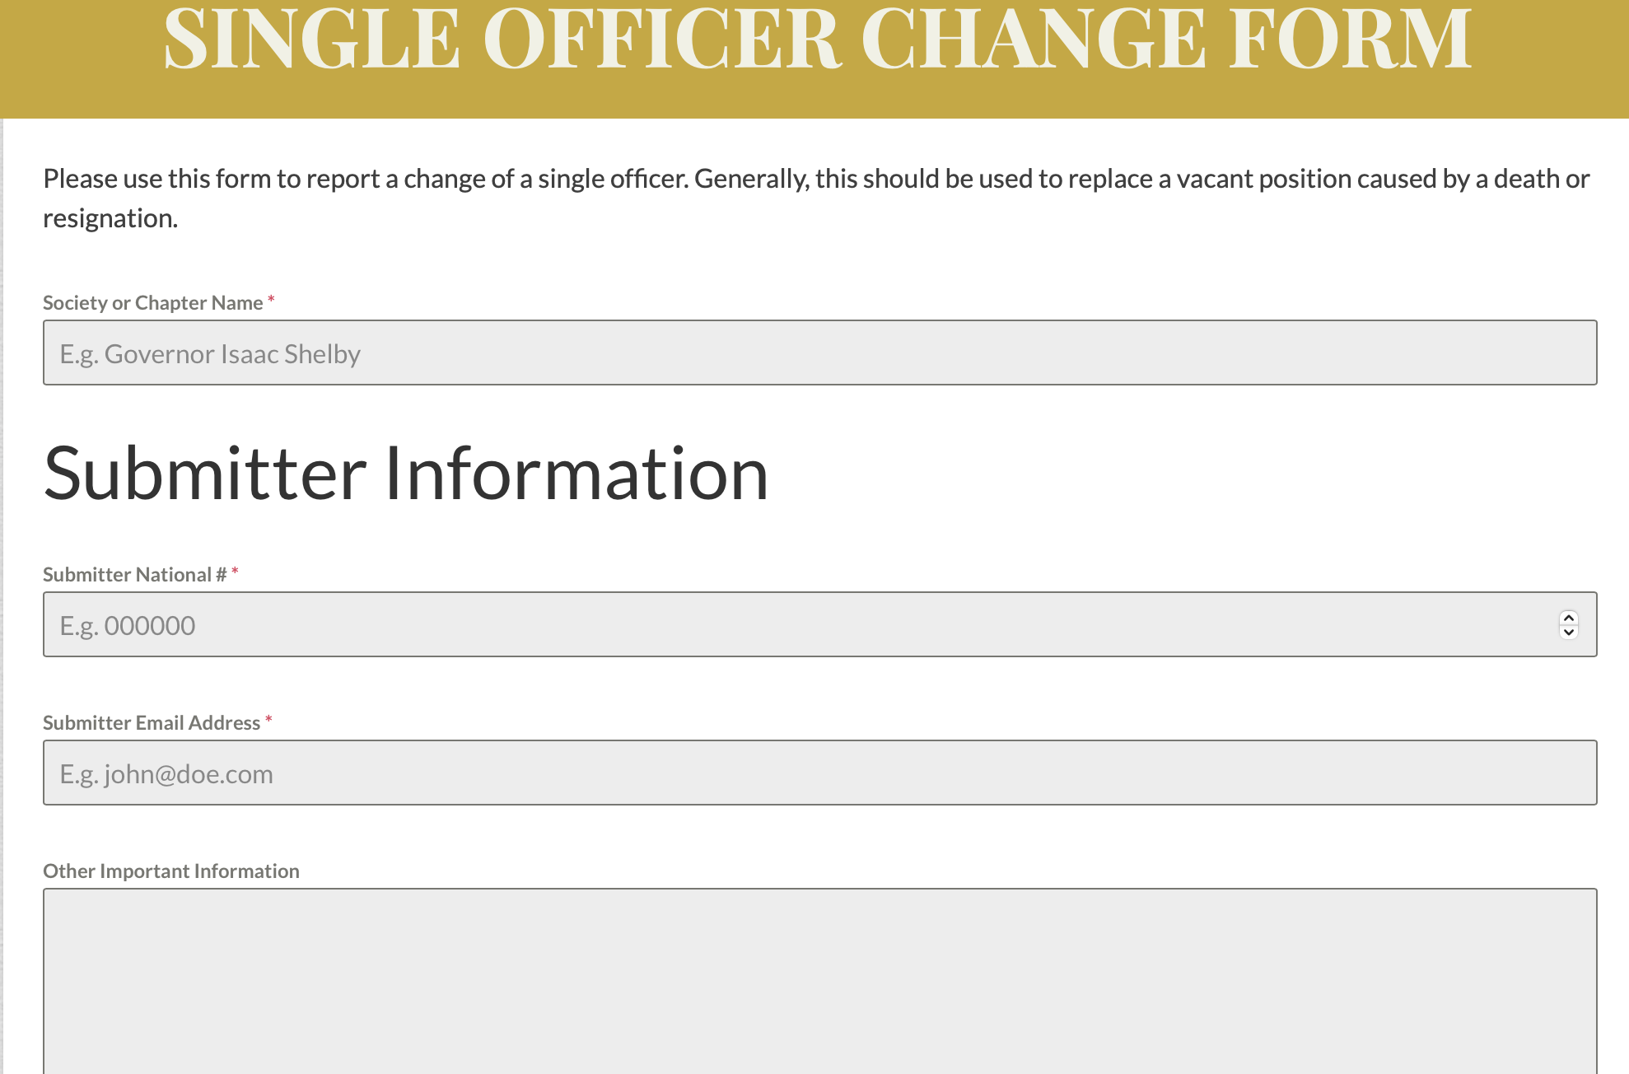

Slide 7
Yellow versus Blue System

Slide 8
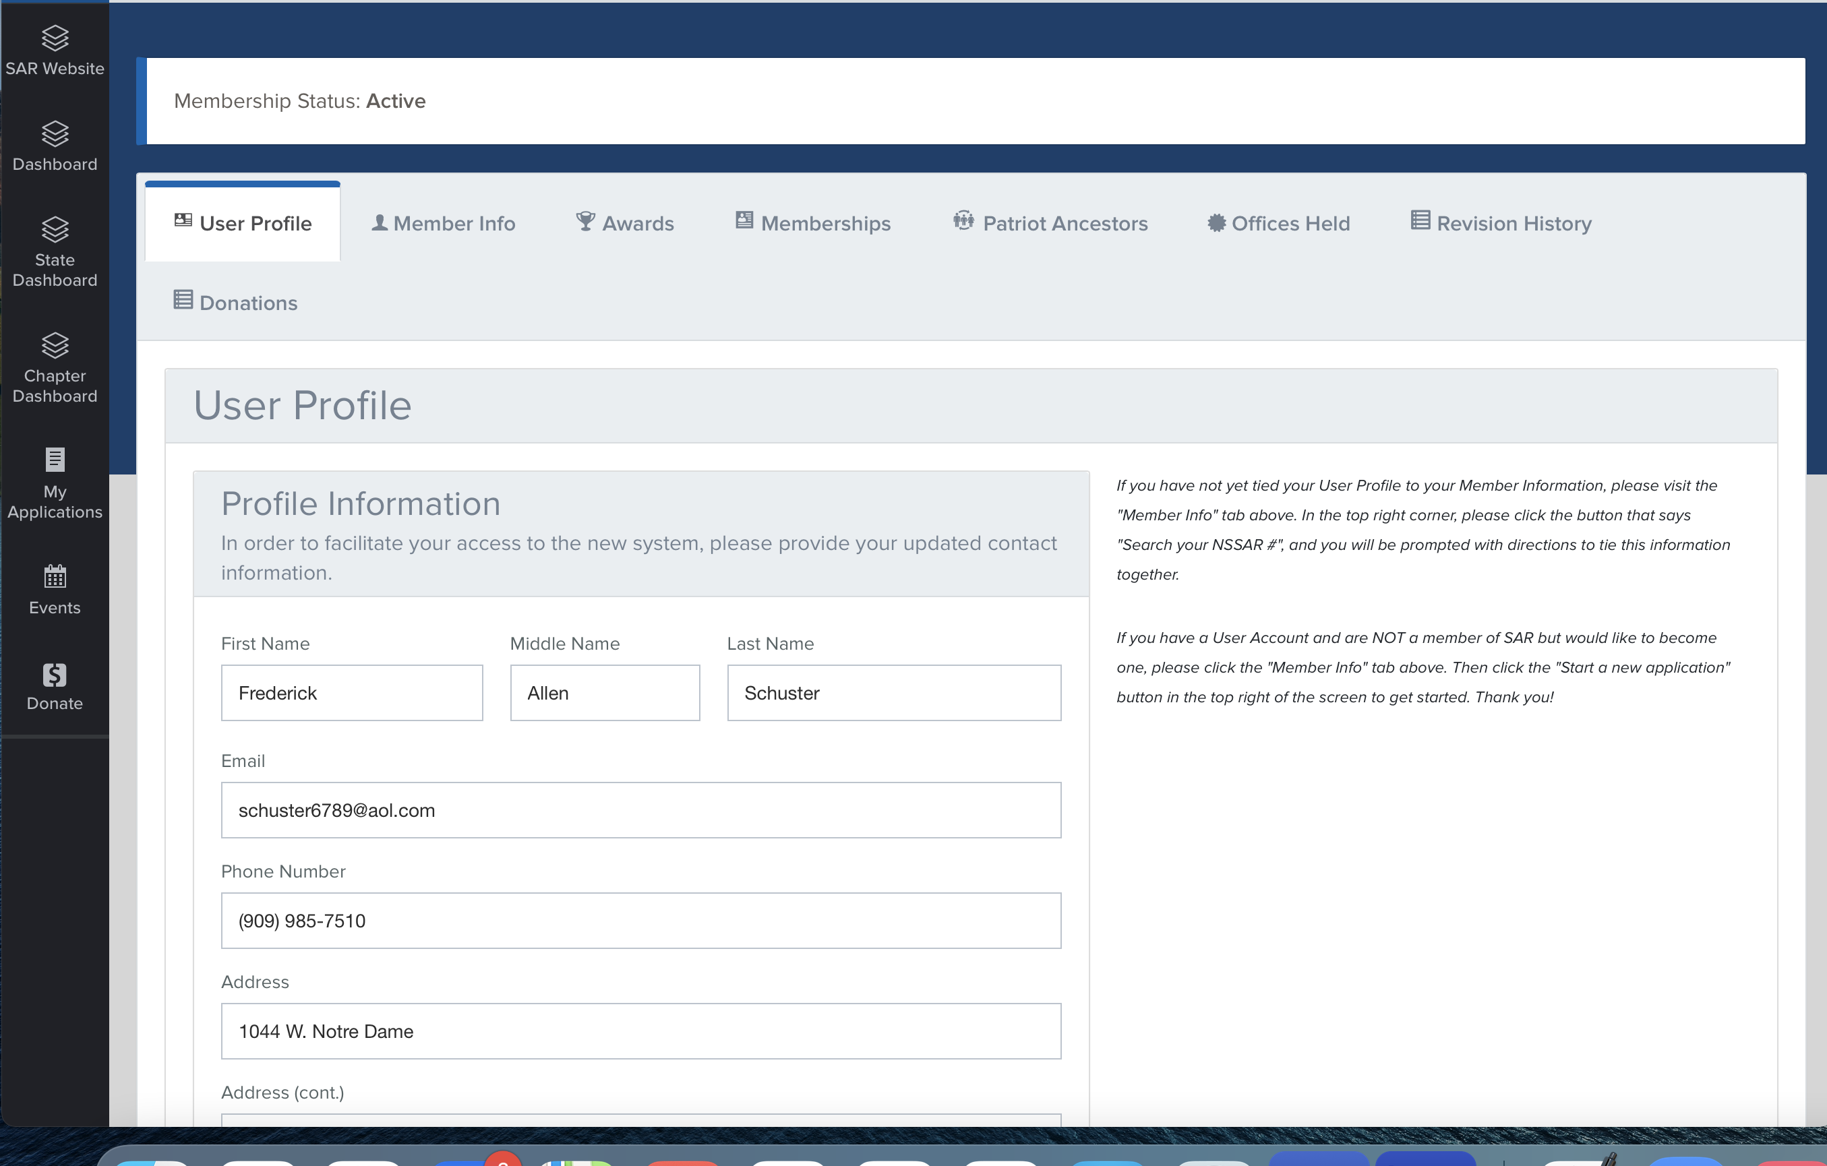

Slide 9
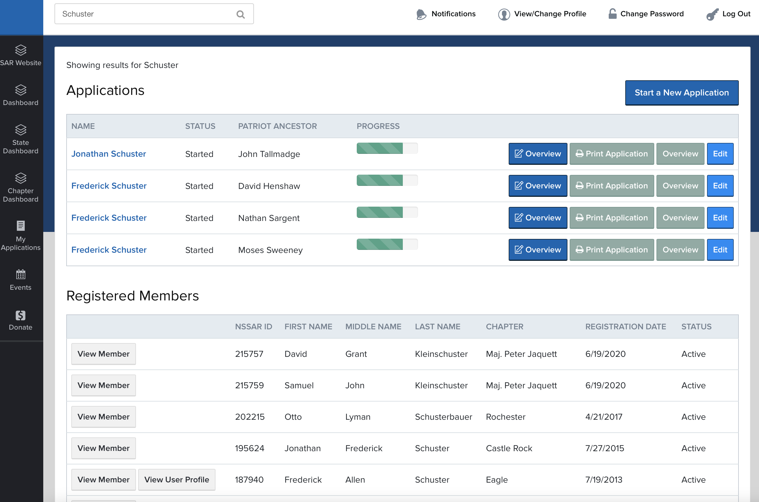

Slide 10
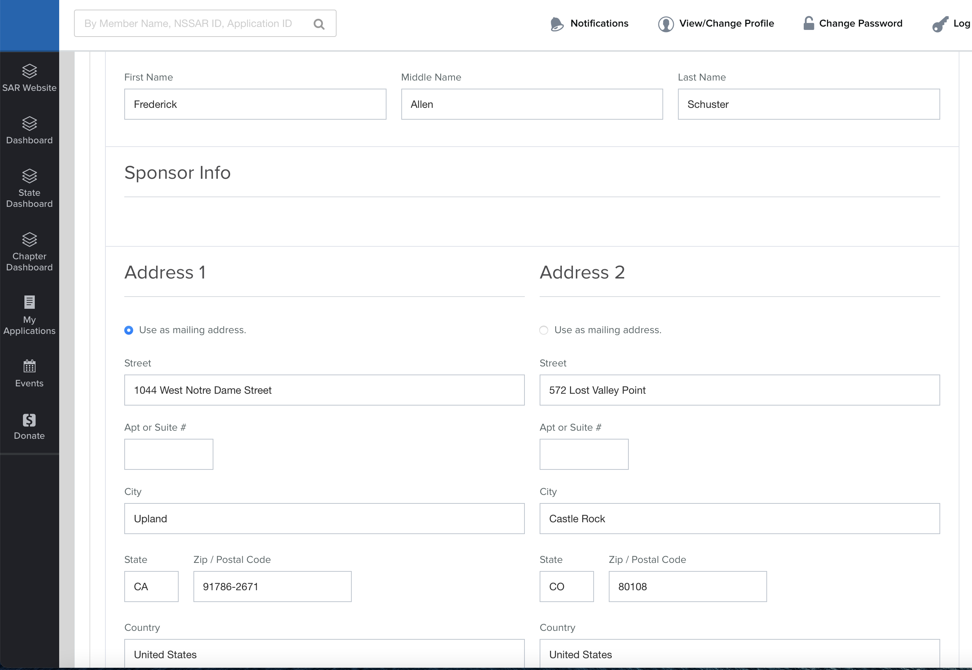

Slide 11
National Web Site

Slide 12
Dates to Remember
September 1st 2021, members do not pay any dues to CASSAR or National if admitted to Society on or after this date.
October 1st CASSAR Dues Campaign begins.
November 1, 2021 no reinstatements or transfers into the California Society will be completed until January 2022.
December 15th 2021-last date to collect membership dues.
January 5th is the date set by the CASSAR bylaws for chapters to report membership.
January 5th is the date chapter dues are due to CASSAR.
CASSAR must have a clean roster as of January 1, 2022

Slide 13
Why these dates
December 15th and January 5th are set by the California State Society By-laws to provide sufficient time to prepare the California State Membership and Financial Reconciliation Report that must be submitted to National by the last working day in January.
January 31, 2022 is set by NSSAR Bylaws for all State Societies.
No state transaction are processed until the NSSAR dues are paid.
In 2022 this is January 31, 2022.

Slide 14
Life Members-Four Different
What are they?
California Life Member-Old Program
California Life Member-New Program
NSSAR Life Member
Emeritus Member

Slide 15
California Old Life Members
Most of the Life member in each of the chapter will be in the “OLD” Life category. These life members were under an older program where the California Society agreed to pay the State and National Dues and to pay the chapters a portion of their dues annually.
NSSAR does not recognize CASSAR Old Life Members and they show up in the NSSAR Data Base as Regular members.
Members can no longer sign up to be in the “old” California Life program and must get a NSSAR Life Membership Number to become a California Life Member.

Slide 16
California Old Life Members
A California Life Member does not have a NSSAR Life number and is not recognized by NSSAR as being a Life Member.
The California Life Members dues must be paid by CASSAR to National like any other Regular Member-this is why they MUST be singled out on the Reconciliation Report.
You can determine a ”New” Life Member from and ”Old” Life Member by looking at the NSSAR Data Base column under Life Member, new life members will have their NSSAR Life Membership number listed.

Slide 17
Life Members-Old Program
CASSAR LIFE MEMBERS DOCUMENTATION SHEET - OLD PROGRAM
 | Society: | Master |  | Reconciliation as of January 1, | 2021
 | Nat'l # | First Name | Middle Name | Last Name | Chapter | Birthdate | Emeritus |  | Chapter
1
2
3
4
5
6
7
8
9
10
11
12
13
14
15

Slide 18
California New Life Members
At the Spring Meeting in 2014 the CASSAR membership voted to change from the “OLD” California Life Program to the NSSAR Program.
After April 2014 a member that desired to become a California Life member had to first become a NSSAR life member and receive a National Life member number. After being accepted as an “National” life member the member could apply to the California Society to be a California Life Member under the “New” program.
The New California Life program works in much the same way as the “Old” California program it is just different in how the member becomes a California Society Life Member.

Slide 19
Life Members-New Program
CASSAR LIFE MEMBERS DOCUMENTATION SHEET - NEW PROGRAM
 | Society: | Master |  | Reconciliation as of January 1, | 2021
 | Nat'l # | First Name | Middle Name | Last Name | Chapter | Birthdate | Emeritus
1
2
3
4
5
6
7
8
9
10
11
12

Slide 20
NSSAR Life Member
A California Society member may have paid to become a NSSAR Life member and received his national number and decided not to become a California Society Life Member for a variety of reason, the cost, planning to move out of state, ect.
If a California Society member paid to be a NSSAR life member but did not apply to be a California Life member then he is a NSSAR life member only and must pay both chapter dues and California State dues during the dues campaign.
Chapters need to keep track of NSSAR Life Members.

Slide 21
NSSAR-Life Member
NATIONAL LIFE MEMBERS DOCUMENTATION SHEET
 | Society: | Master |  | Reconciliation as of January 1, | 2021
Do not include CASSAR Life Members whose National dues are paid under the CASSAR LM Fund
 | Nat'l # | Natl Life # | First Name | Middle Name | Last Name
1
2
3
4
5
6
7
8
9
10
11
12

Slide 22
Emeritus Members
Emeritus-Life Time Member is a member that has 50 years of paying dues to the Sons of the American Revolution, it does not have to be continuous.
The California Society must apply to NSSAR to have a member placed into the Emeritus Life Program.
The California Society pays no National dues for Emeritus Members.

Slide 23
Emeritus-Life Time Member 50 years continuous service
EMERITUS MEMBERS DOCUMENTATION SHEET
 | Society: | Master | Reconciliation as of January 1, | 2021
Emeritus members are compatriots who have paid dues in at least 50 years
 |  |  |  |  | CASSAR LM
 | Nat'l # | First Name | Middle Name | Last Name | Y or N | Chapter
1
2
3
4
5
6
7
8
9
10
11
12

Slide 24
Memorial Members
Some Chapters have submitted new member applications this past year and in previous years to have members parents or grandparent be admitted as a Memorial members of the National Society.
A Memorial member is not an active member and should be listed as a deceased member of the chapter so the member can be removed from the roster.
A Memorial Member is not an Active member of the CASSAR Society and needs to be listed as deceased Member.

Slide 25
Chapter Rosters
Chapters are required to submit a 2021 membership roster and a 2022 membership roster.
WHY?
The only way to cross check the membership of the society is to have a past roster and a current roster.

Slide 26
Junior Members
If a junior member turns 18 at any time in the calendar year 2021 then he will be a Regular member and dues need to be collected as a Regular member.
Remember that the chapter or the California Society does not get any dues for Junior members; Chapters should consider, just carrying their junior members and just paying their $5 dues fee.
Birth year is the most important, if you do not know a month or day use June 15th and it will work fine, MUST have the correct birth year.
The cost to collect the $5 can be as much or more as the $5.
If the Junior member is not 18 on January 1, 2022 then he is still a Junior member for all of 2022.

Slide 27
Deceased Members
We all have members that pass away during the year, our organization is an aging organization.
Again the exact dates are not as important as knowing that it was on or before Dec 31st
In the Case of a Life Member, let me know up to January 15th by email, if it is after January 1st and I will make the change in the Reconciliation Report going to National.

Slide 28
New Members After Dec 15th
Any new members that are received after December 15th 2021, National will make the correction in the Reconciliation Reports.
This will result in the amount of money you chapter may own and the agreed upon number of members.
New Members admitted before December 15th need to be included in the chapters Reconciliation Report.
I keep a file on all applications received in December and will check your report and will try to add the members if they are not in the report when submitted.

Slide 29
Dual State Members
A Dual State Member, is a member that pays his National, State and Chapter dues in another state and only pays chapter and state dues to the California Society.
The Chapter must collect dues for all Dual California Society Members and list the dual member on the Reconciliation Report.
The chapter has the obligation to find out if the Dual Member has paid their National Dues through another state.
According to National bylaws, Dual state members cannot hold chapter or state executive board or committee chair positions in the state where they are a Dual member.

Slide 30
Dual State Members
CASSAR DUAL MEMBERS DOCUMENTATION SHEET
 | Society: | Master |  | Reconciliation as of January 1, | 2021
 |  |  |  |  |  | Primary
 | Nat'l # | First Name | Middle Name | Last Name | Chapter | State is CA
 |  |  |  |  |  | "y" or "n"
1
2
3
4
5
6
7
8
9
10
11
12

Slide 31
Transfers In and Out and Reinstatements
Don’t let specific dates be your undoing.
Key dates for the purpose of the report are before September 1st and after September 1st
If a member was transferred or reinstated in the spring use June 15, 2021 as the date if you do not know the exact date. The 15th of the month will always work for the day on all transactions in the report.
This is important, so do not spend a lot of time finding an exact date.
Also, dates can be found in the NSSAR Data Base.

Slide 32
Dates on Report
Where to find information:
Log into the National web site
On the Navy Blue Bar there is a tab “Quick Links.” hit this tab.
Go to Member Info (yellow)
Login into site-note this has a different login name and password.
Type in the last name of the member and hit search.
Go into select member and look in member status.
Or use the Blue System, it works much the same way-we will learn more about the Blue system as the months pass.

Slide 33
Information Needed
When collecting your dues you will need to confirm the following information.
Name
Address
Email (important: when the society goes to electronic payment each member will have to use an email address to pay dues.)
Phone numbers
Need to confirm information on life member.

Slide 34
General Comments
Fill in all fields in the work sheets.
Do Not delete anything on the work sheets. Your report will be rejected and you will have to redo the entire report.
Do not change any of the formulas or numbers on any of the sheets.
Begin to fill in the Reconciliation Report as soon as you receive the report. The report can be filled in before December 15th with the exception of the drops.
Call if you need assistants (909) 985-7510
Did I say Call if you need Assistance (909) 985-7510

Slide 35
QUESTIONS
OPEN FORUM FOR QUESTION
Ask any question!

