Slide 1
Open Forum
California Society
Training Session
December 2022

Slide 2
Dates to Remember
December 15th 2022-last date to collect membership dues
January 5th is the date set by the CASSAR bylaws for chapters to report membership.
January 5th is the date chapter dues are due to CASSAR.
CASSAR must have a clean roster as of January 1, 2023

Slide 3
Why these dates
December 15th and January 5th are set by the California State Society By-laws to provide sufficient time to prepare the California State Membership and Financial Reconciliation Report that must be submitted to National by the last working day in January.
January 31, 2023 is set by NSSAR Bylaws for all State Societies.
No state transaction are processed until the NSSAR dues are paid.
In 2023 this is January 31, 2023.

Slide 5
Newly Elected Chapter Officers Report Important
NSSAR has changed how the National Data system access will work in 2023.
Chapter must file this report for their officers to have access to the National Data System in 2023.
The last date set by CASSAR to file the report is January 31st.
All current and past chapter officers will not have access to the system after February 2023 if the report is not filed.
Only four (4) chapter positions can have access to chapter data – President, Vice Presidents, Secretary and Registrar.

Slide 6
New information on the NSSAR Web For the Chapters
Chapter Secretary’s can report the death of a chapter member.
Chapter secretaries can now change a members address directly in the new system.
Chapters can run their own reports on membership.
Chapters can find and fill out many of the forms for membership.

Slide 8
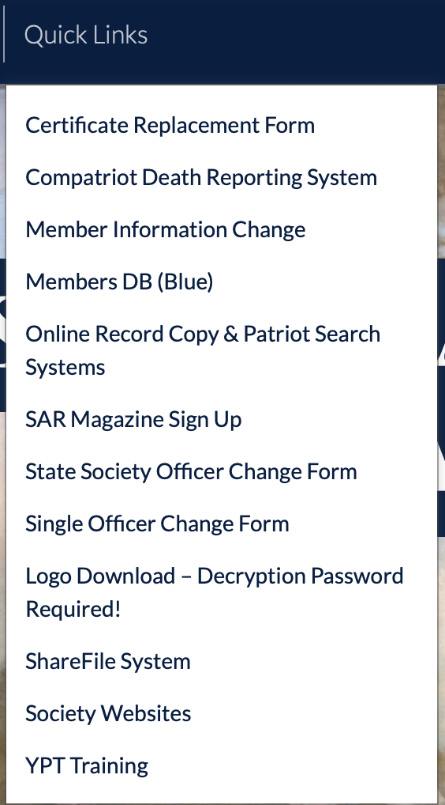

Slide 9
Memorial Members
Some Chapters have Memorial members.
A Memorial member is not an active member and should be listed as a deceased member of the chapter so the member should be removed from the roaster.
A Memorial Member is not an active member of the California Society and needs to be listed as deceased Member on the Reconciliation Report.

Slide 10
Chapter Rosters
Chapters are required to submit a 2022 membership as of January 1st roster and a membership roster as of December 31st 2022.
Why????
This only way to cross check the membership if something is incorrect later in the year at National or in the California Society records.

Slide 11
Junior Members
If a junior member turns 18 at any time in the calendar year 2022 then he will be a Regular member and dues need to be collected as a Regular member. Up to and including December 31st.
Remember that the chapter or the California Society does not get any dues for Junior members; Chapters should consider, just carrying their junior members and just paying their $5 dues fee.
If the birth year is 2004 of earlier than the member is not a junior member..
The cost to collect the $5 can be as much or more as the $5, chapters may wants to consider paying the dues for their junior members as a policy.
If the Junior member is not 18 on December 31, 2022 then he is still a Junior member for all of 2023, even if he turns 18 on January 1, 2023.

Slide 12
Deceased Members
We all have members that pass away during the year, our organization is an aging organization.
Again the exact dates are not as important as knowing that it was on or before Dec 31st
In the Case of a Life Member, let me know up to January 15th by email, if it is after January 1st and I will make the change in the Reconciliation Report going to National.
In the New National Data system it is much easier to get members information once you are familiar with the system. Call me and we can work through the system if you have an issue.

Slide 13
New Members After Dec 15th
Any new members that are received after December 15th 2022, National will make the correction in the Reconciliation Reports.
A members final approval date can be found on the back of the members Record Copy – each chapter gets a copy for your records. Also it can easily be found in the National system.
New Members admitted before December 15th need to be included in the chapters Reconciliation Report and in the 2022 Roster.
I keep a file on all applications received and will check your report and will try to add the members if they are not in the report when submitted.

Slide 14
Dual State Members
A Dual State Member, is a member that pays his National, State and Chapter dues in another state and only pays the California Society chapter and state dues .
The Chapter must collect dues for all Dual California Society Members and list the dual member on the Reconciliation Report.
The chapter has the obligation to find out if the Dual Member has paid their National Dues through another state.
NOTE: According to National bylaws, Dual State Members cannot hold chapter or state board or committee chair positions in the state where they are a Dual member.

Slide 15
Transfers In and Out and Reinstatements
No Transfers are accepted by the California Society in December.
Key dates for the purpose of the report are before September 1st and after September 1^{st.}
Dates can be found in the NSSAR Blue Data Base.
If a member was transferred or reinstated in the spring use June 15, 2022 as the date if you do not know the exact date. The 15th of the month will always work for the day on all transactions in the report.
Again the dates can be found in the National Data system easily.

Slide 16
Dates on Report
Where to find information:
Log into the National web site
On the Navy Blue Bar there is a tab “Quick Links.” hit this tab.
Go to Member DB (Blue)
In the middle of the page is a Chapter locator. Locate your chapter on the pull down.
At the top of the page type in the members first and last name only and hit the little search hour glass to the right. And the name should appear.

Slide 19
Information Needed
When collecting your dues you will need to confirm the following information.
Name
Address
Email (important: when the society goes to electronic payment each member will have to use an email address to pay dues.)
Phone numbers
Need to confirm information on life member.

Slide 20
General Comments
Fill in all fields in the work sheets.
Do Not delete anything on the work sheets. Your report will be rejected and you will have to redo the entire report.
Do not change any of the formulas or numbers on any of the sheets.
Begin to fill in the Reconciliation Report as soon as you receive the report. The report can be filled in before December 15th with the exception of the drops.
Call if you need assistants (909) 452-7617
Did I say Call if you need Assistance (909) 452-7617

Slide 21
QUESTIONS
OPEN FORUM FOR QUESTION
Ask any question!

