Slide 1
California Society
Secretary Forum
Transfers, Dual Members, & Reinstatements
January 20, 2021

Slide 2
1
What Now?
Change of Managers Report
Reinstatement Letters
Thank You Notes
National Data Updates
Awards & Medals Project
Year End Reports
Taxes

Slide 3
CASSAR Web Page
Log on to the CASSAR web page.
On the Red tool bar is a tab “Members Section.”
Hit that tab and it will take you to the Members section of the web site.

Slide 4
CASSAR Web Page
On the Members Section of the web site, there are several tabs.
Scroll down to the Secretary Tab.
Hit the Secretary tab and it will open to several forms.

Slide 5
CASSAR Web Page
In the Secretary Tab, are the general forms that chapter secretary's use.
Here is where you will find the form which is the Chapter Change of Officers Reporting Form.
This needs to be filed with the State Secretary so he can send the information to NSSAR to give access to the Chapter Secretary and the Chapter President.
Forms are filed after the Reconciliation Reports are completed and filed with NSSAR.

Slide 6
1
What’s Next
Now that the Reconciliation Reports are completed, what's next?
Change of Managers Report
This form can be found on the CASSAR web site, members section.
Go to the CASSAR Web site.

Slide 7
1
Reinstatement Letters
It is not required that every chapter send members a letter letting them know that their membership has lapsed, it is just a good idea.
It is a good way to make one last attempt to keep your membership.
Send a letter and the reinstatement form which can be found in the secretary's section on the CASSAR web page.

Slide 8
1
Thank You Notes
It is not required that every chapter send its members a thank you note, it is just a good way to let them know you appreciate them.
Remember the members have just paid a considerable amount of money to remain a member of the California Society, paying chapter, state and national dues.
Let your chapter members know that you appreciate them.

Slide 9
1
Updating the
NSSAR Data Base
As the chapter secretary, you have the responsibility to keep the membership records up-to-date for your chapter.
This would include the National Data Base records.
Address
E-mail
Phone numbers

Slide 10
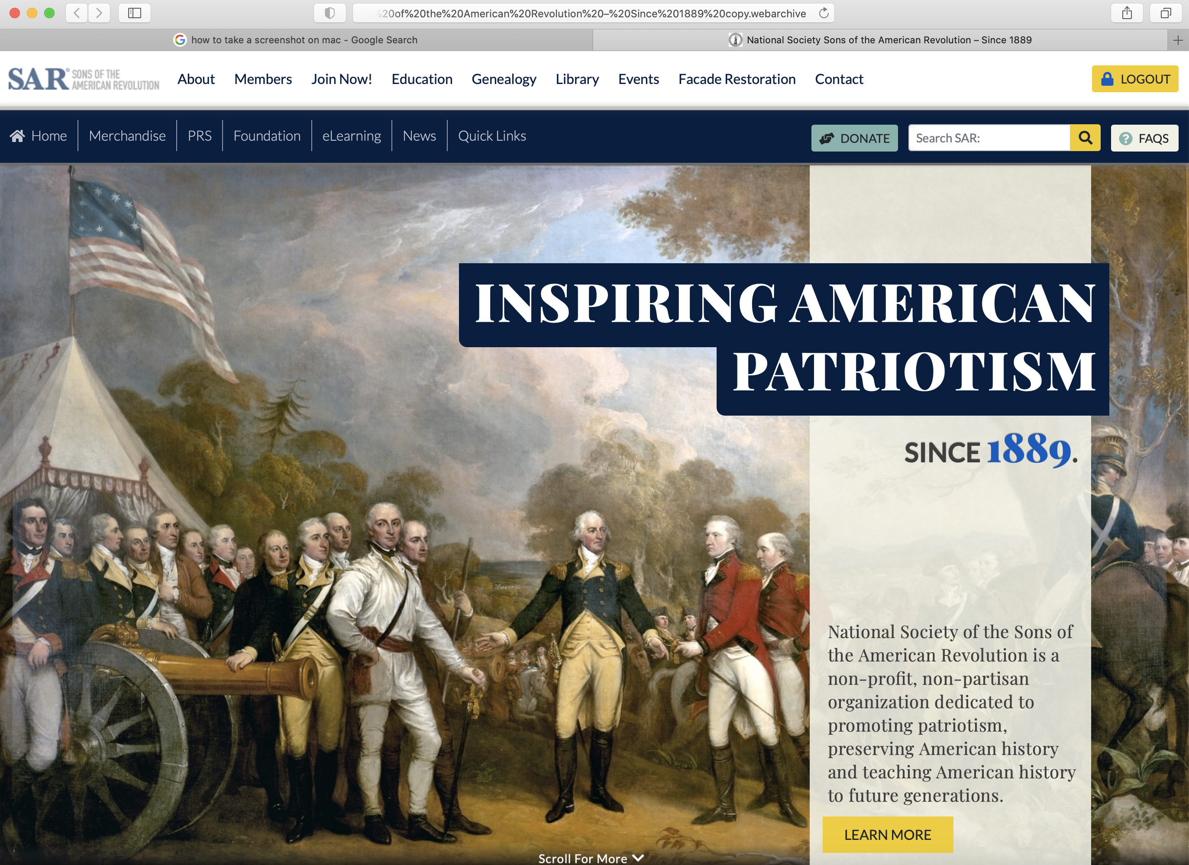
Where do I Find
How do I Log into the National Data Base?
Log into the National Web Site.
On the left side of the Blue Bar is a tab “Quick Links”.
A drop down Box will appear..
There will be a tab, Members Info (Yellow), hit this tab.

Slide 11
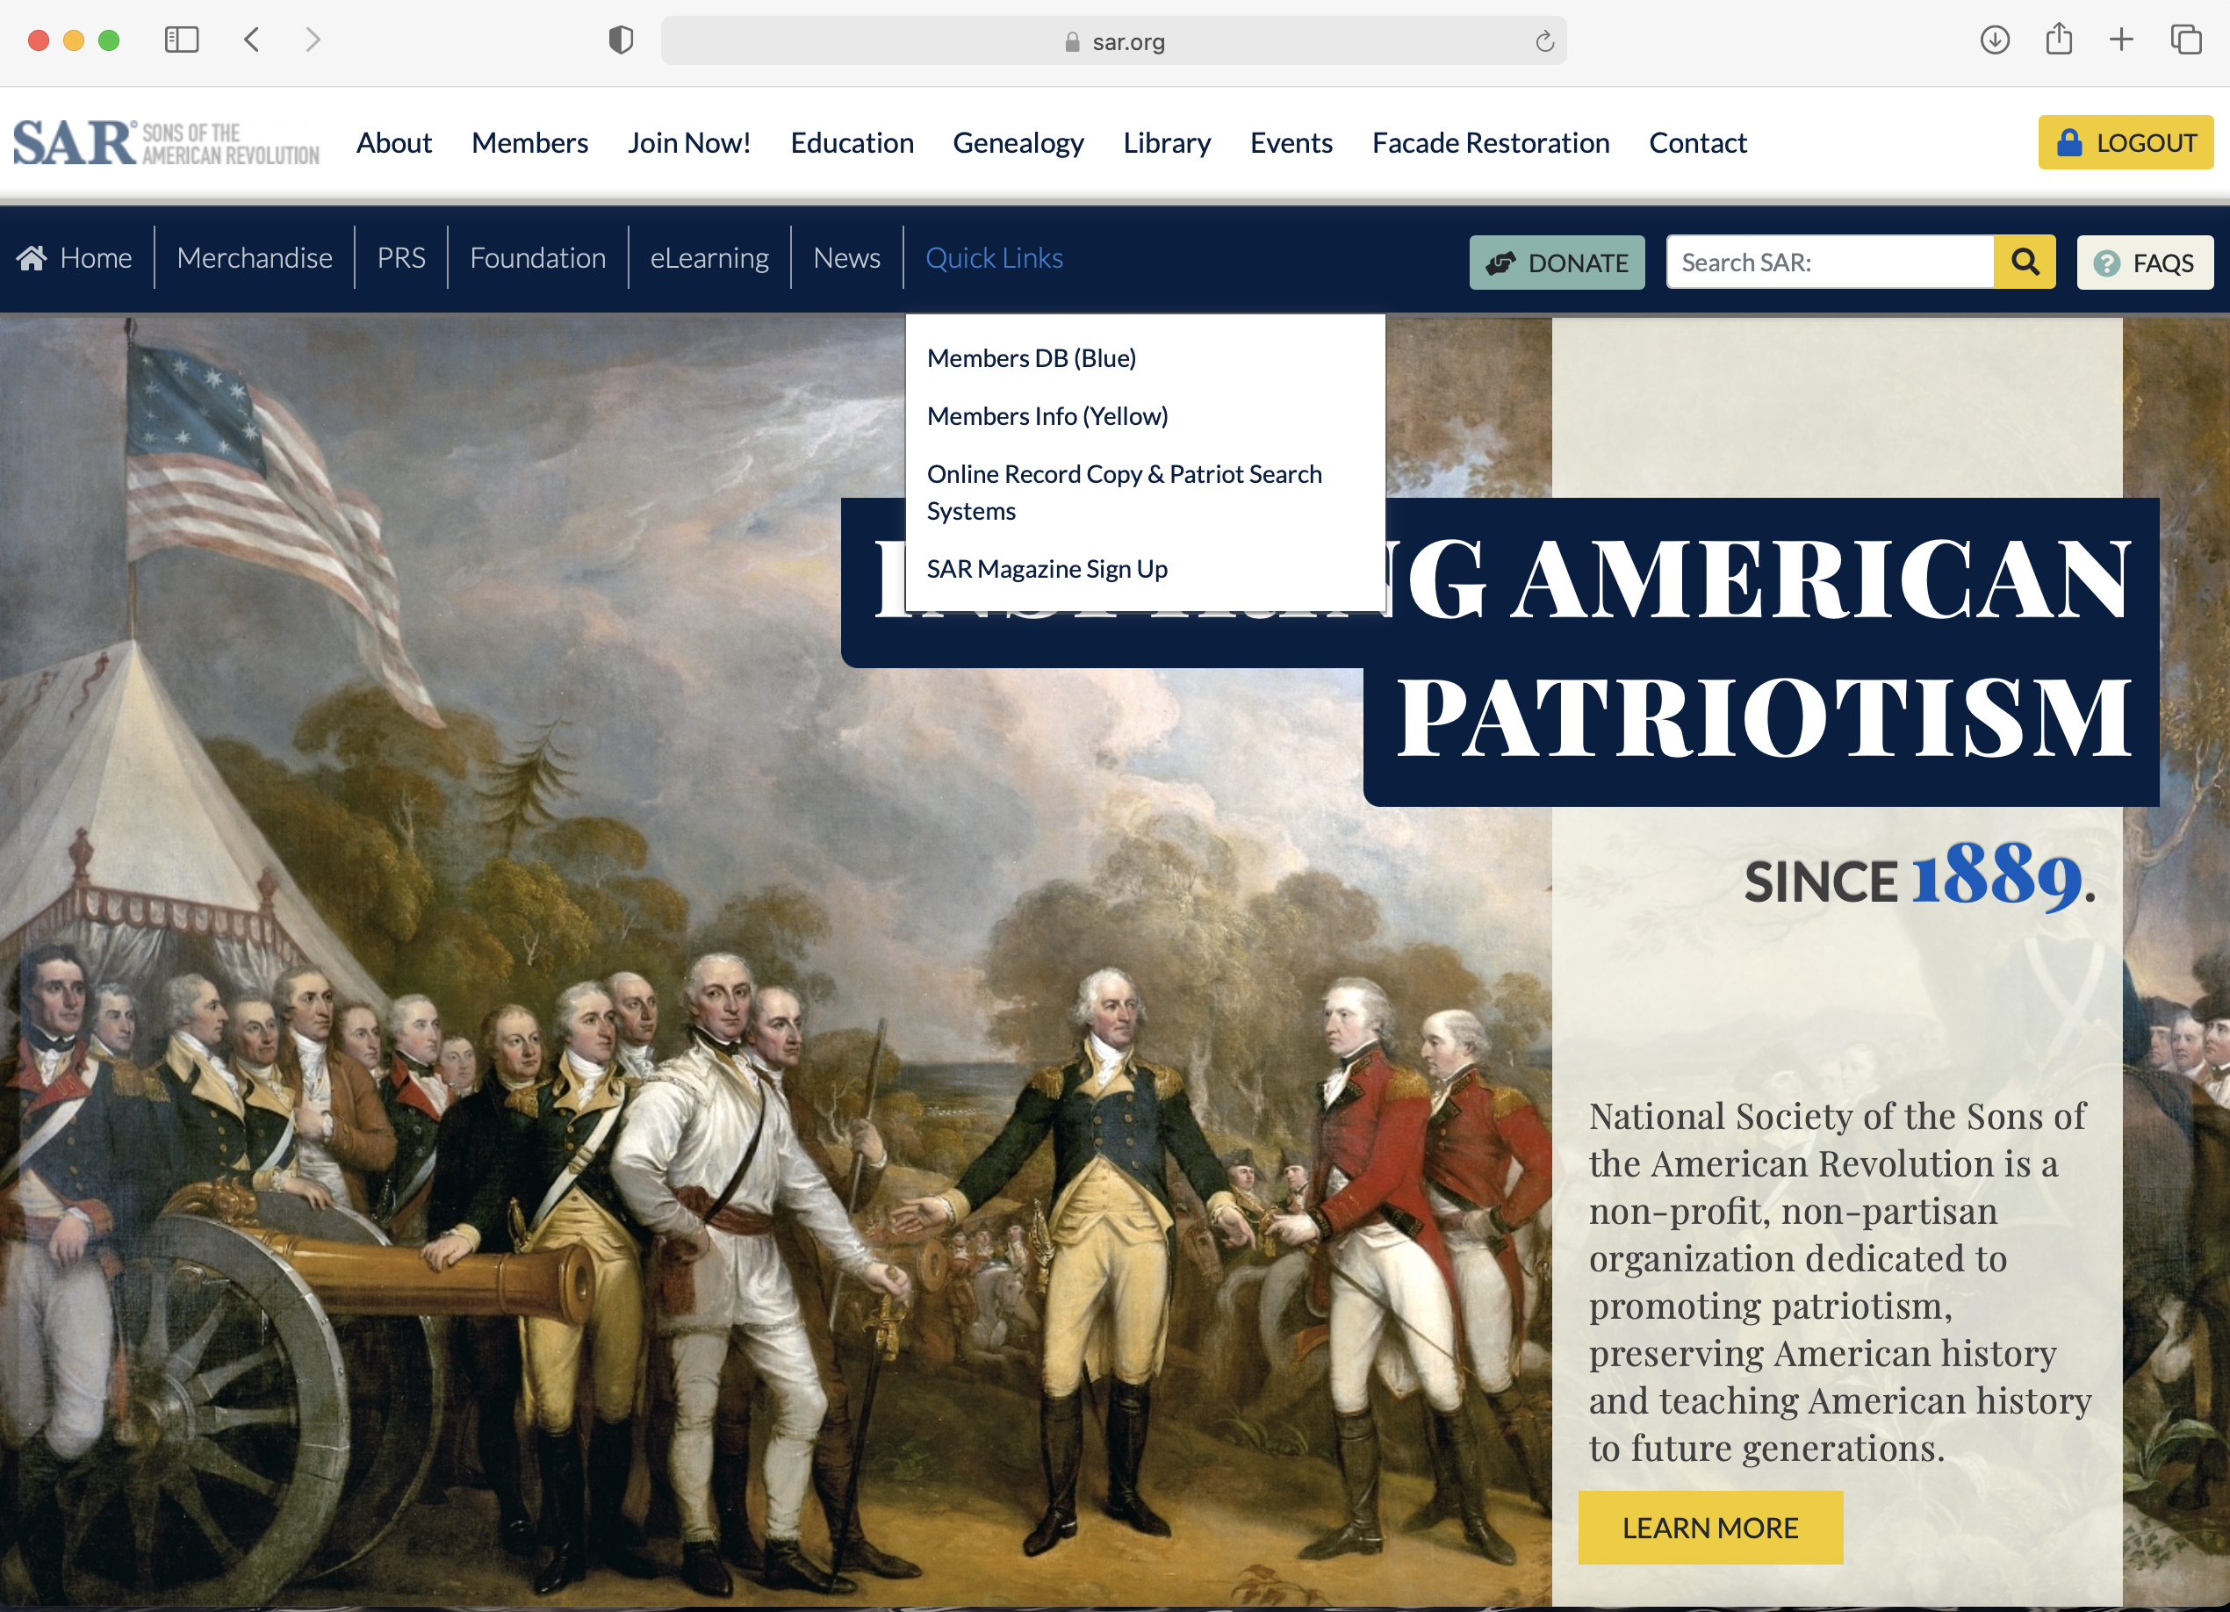
How do I Find the Member I Information
The Member’s Info (Yellow) tab will take you to the National Data Base, old system.
The Yellow Data Base is where all of the current members information is being stored and the Chapter Secretary and Chapter Presidents have access to information in the data base.

Slide 12
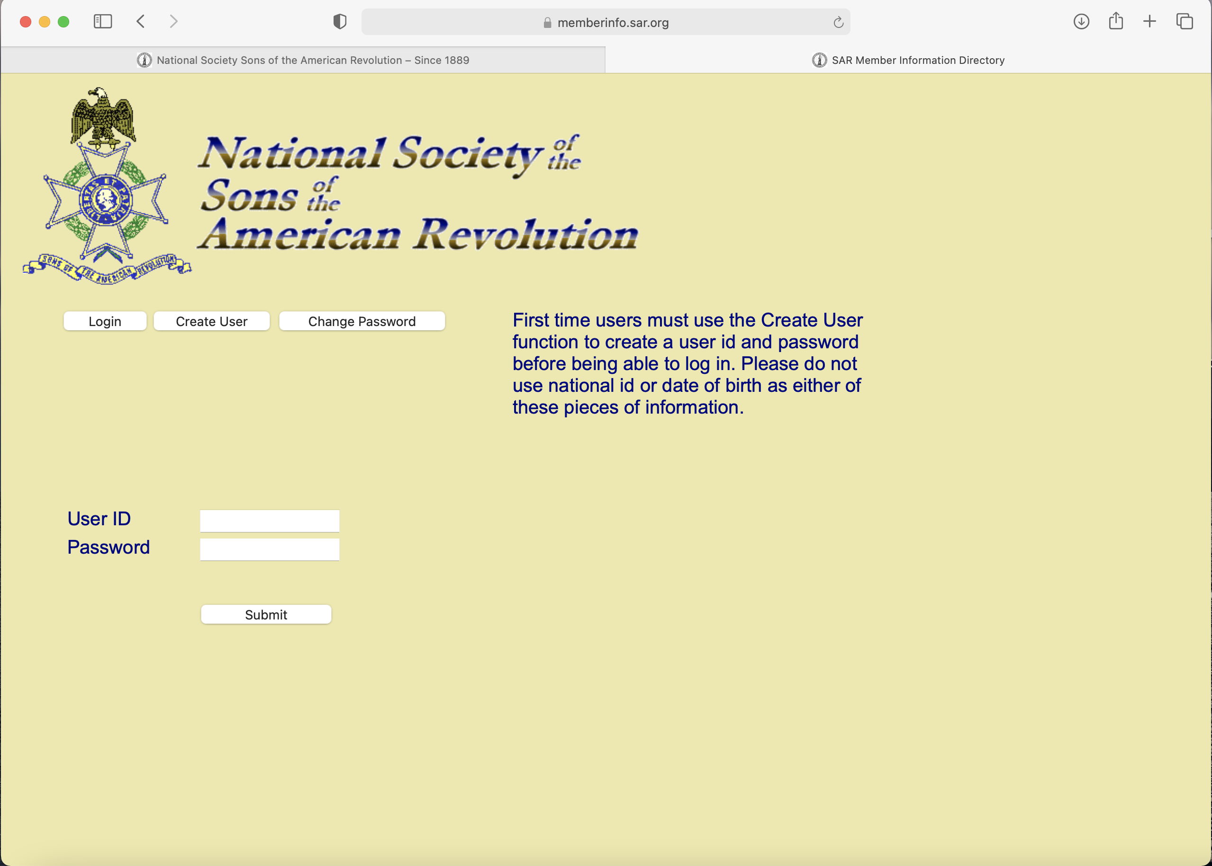
Yellow Data Base
Log into the National Web Site.
At the top of the page is a White Tool Bar.
Look For the “Members” tab.
There will be drop down, go to ”Forms & Manuals.”
Scroll down to the middle of the Forms to the the “Organizational Forms” section.
In this section you will find most of the forms that are used by the chapter secretary in a PDF printable format.

Slide 13
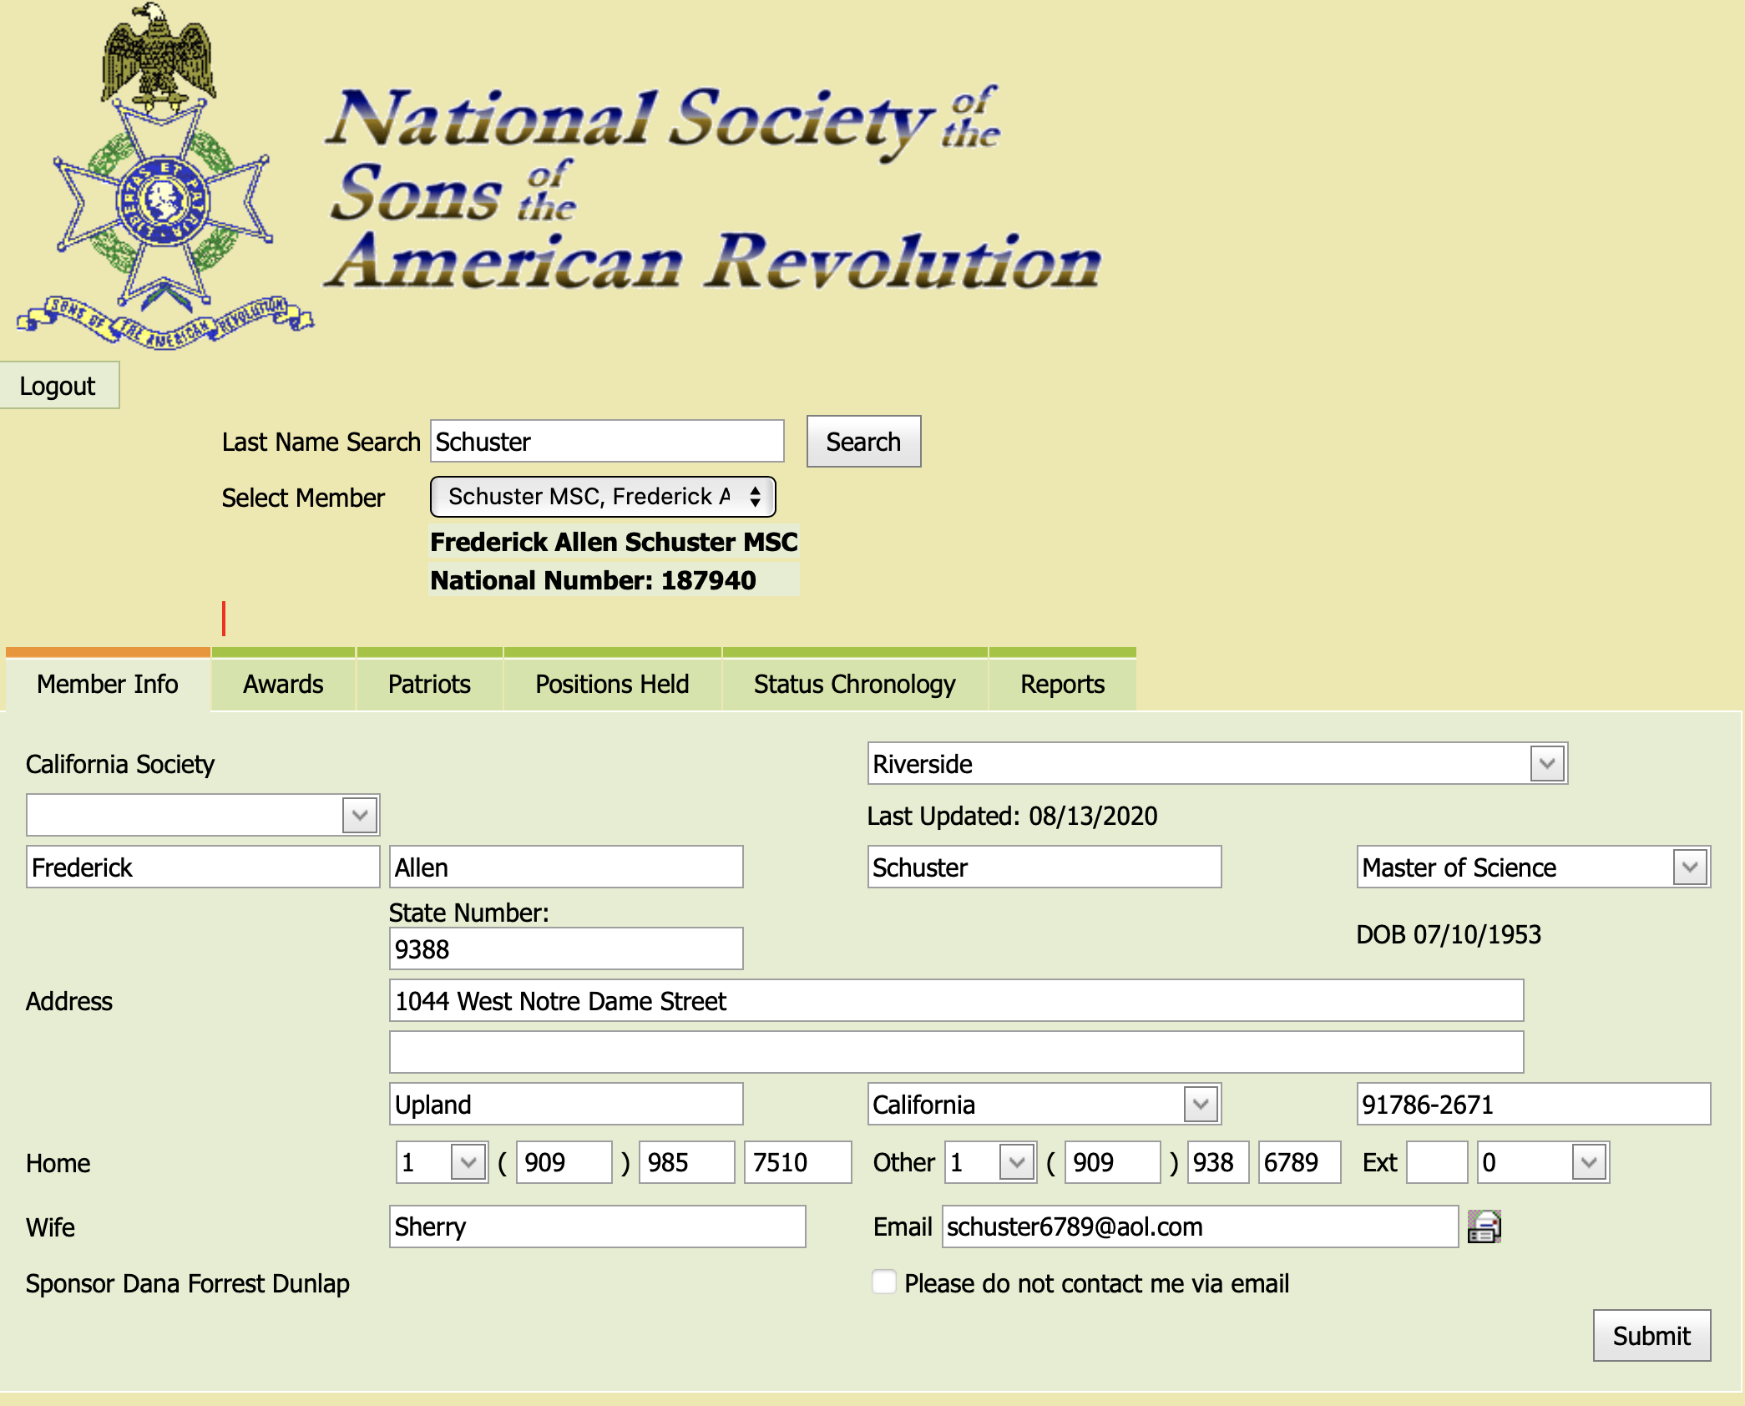
Using the Data Base
Type in the Members name.
Hit the search tab.
There is a set of arrows which will when hit will show all the names of the members with the last name typed into the box.

Slide 14
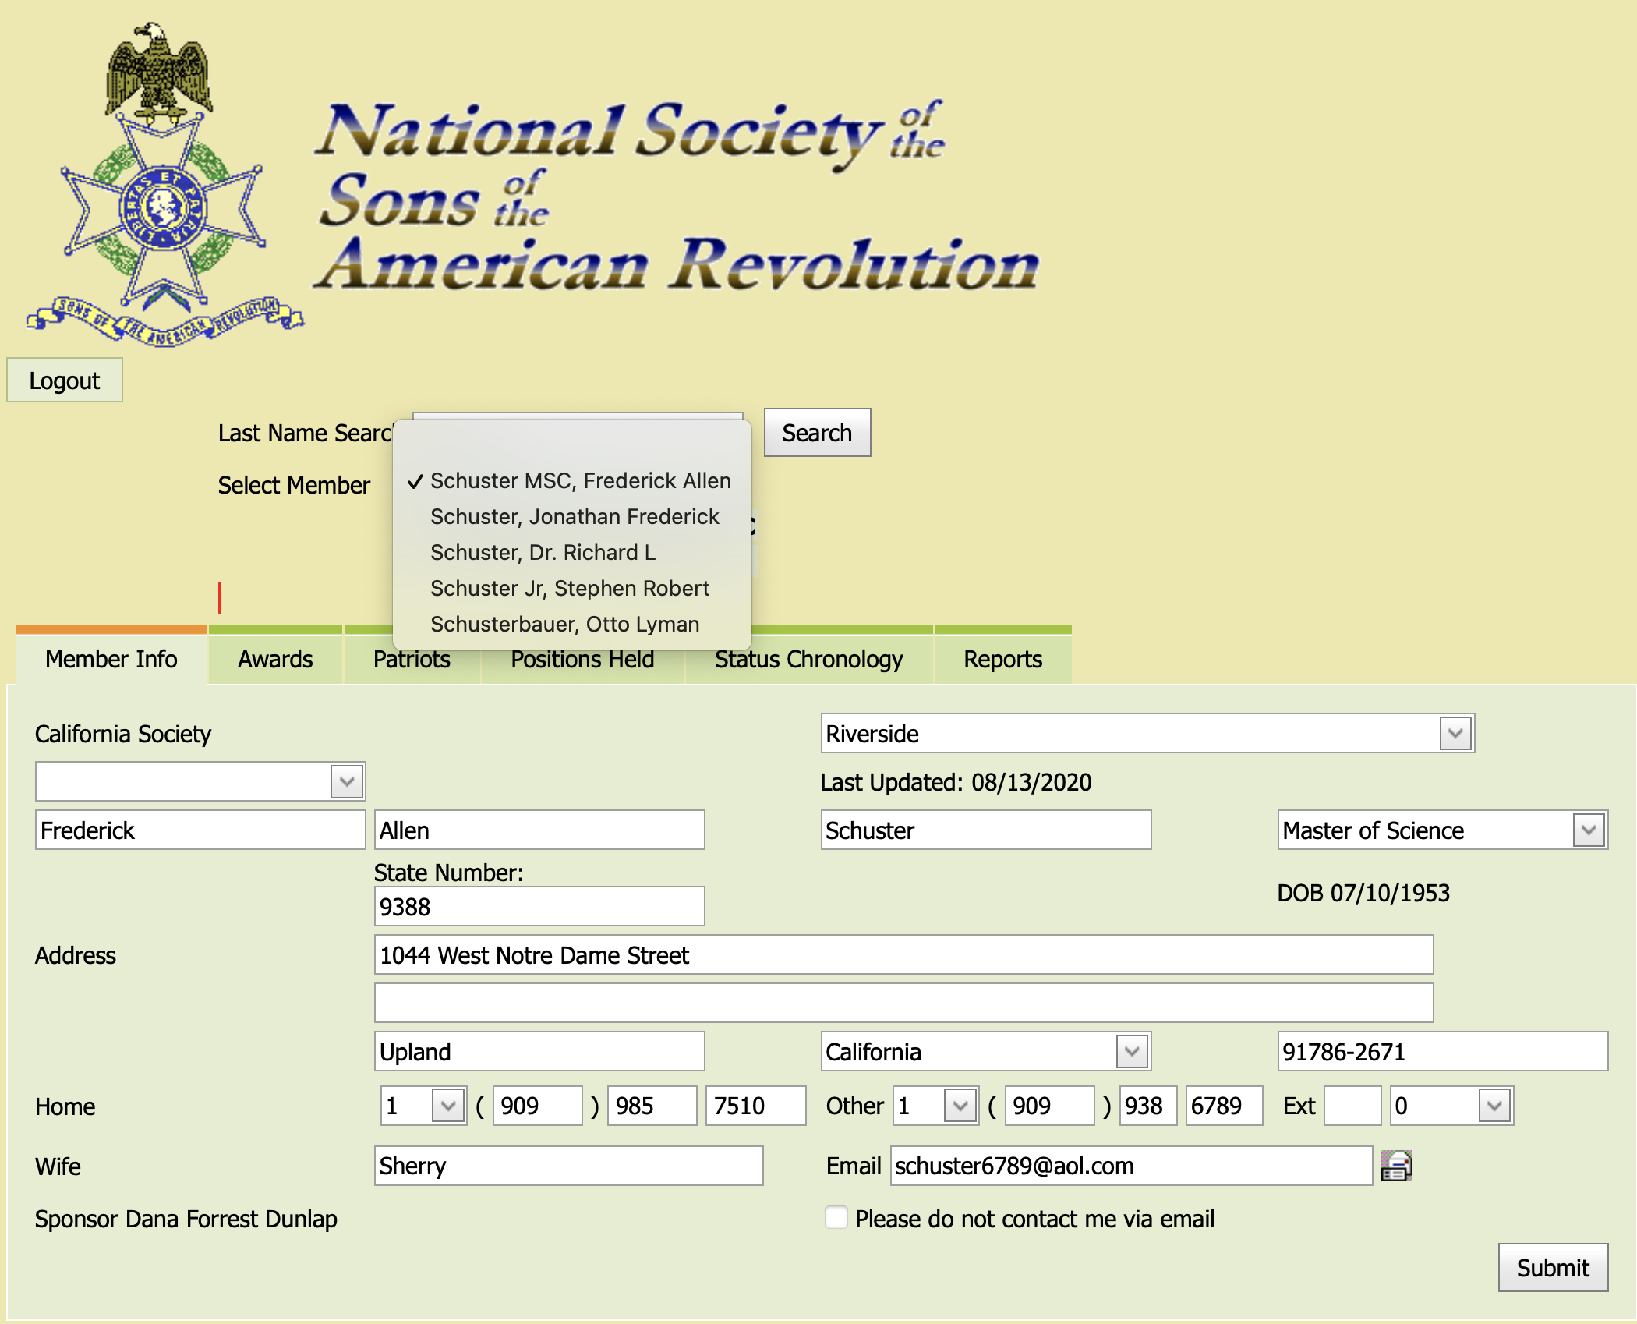
Using the Data Base
In the drop down box find the correct members name and double click.
The members information will show in the in the boxes under the light green bar Member Info.
This is where you can find most of the information about the member.
You can change his address, phone number, wife, E-mail, and degree information.
In this section you can also see the Status of the member.

Slide 15
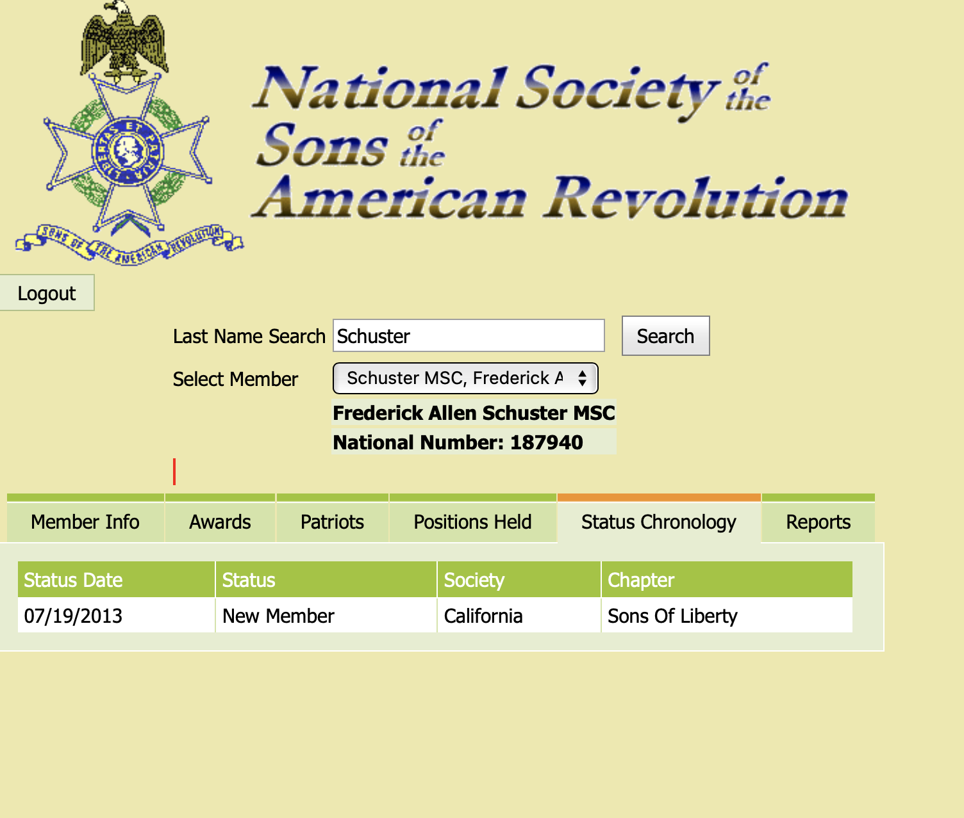
Using the Data Base
The Status Box will show when the member was approved, and the chapter he was a member of when he became a member.

Slide 16
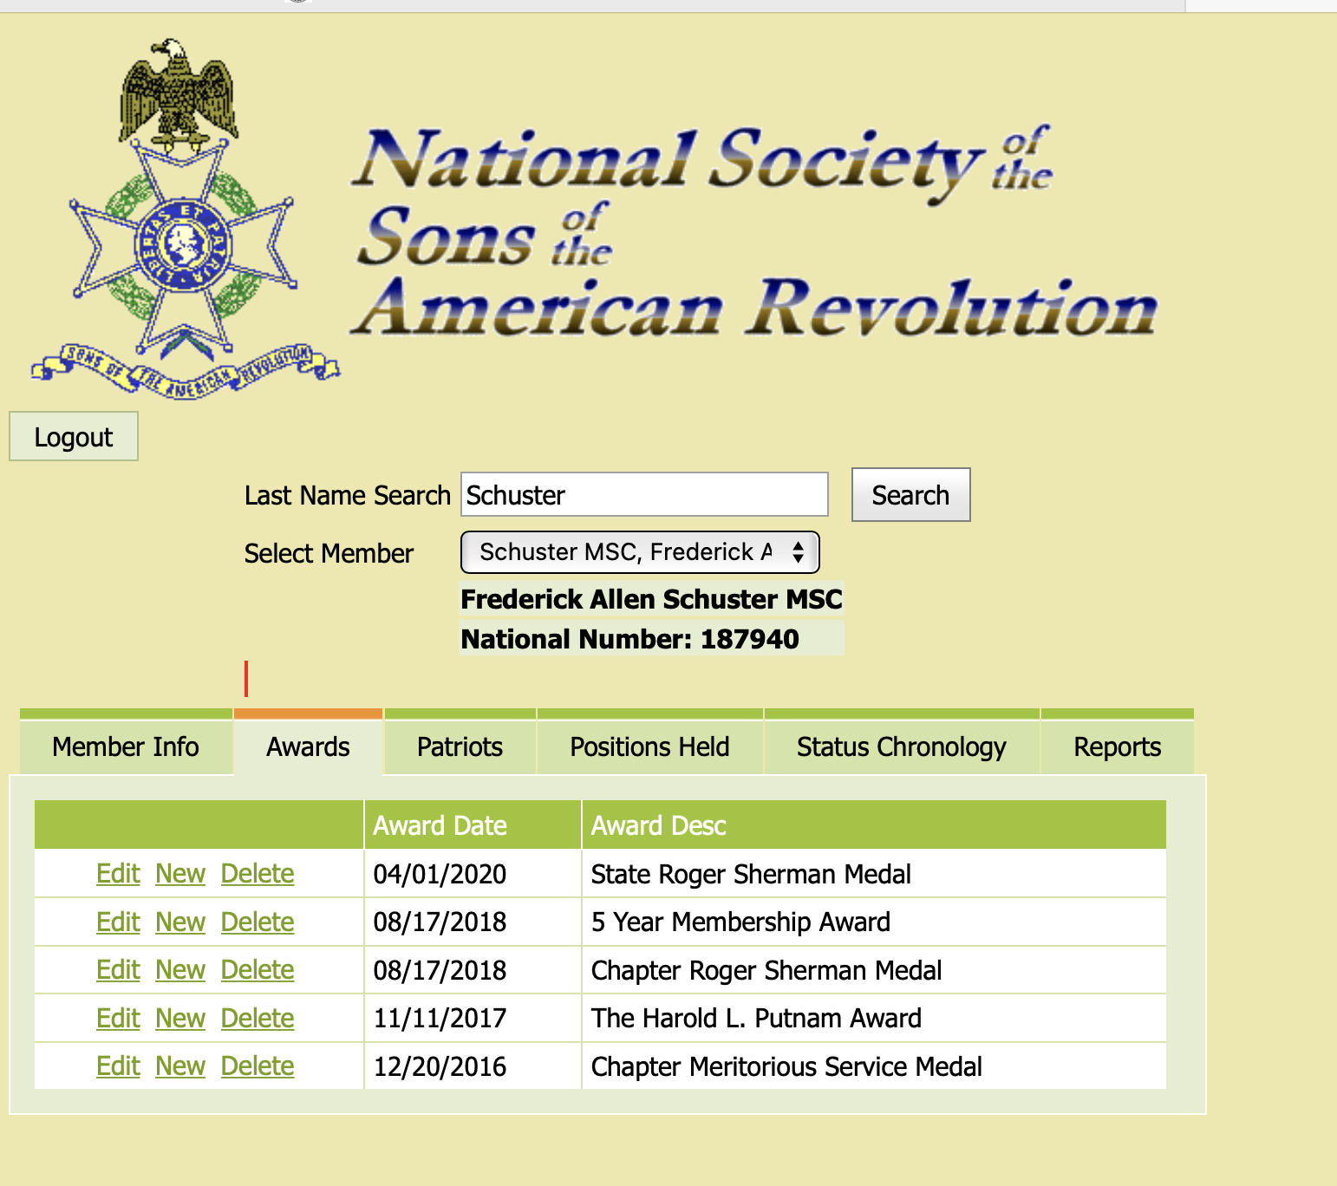
Awards and Medals Project
In CASSAR is taking on a project to update the Awards section of the Yellow Data Base.
Each Chapter Secretary will be asked to send to the CASSAR Secretary the list of Active Members their awards and medals.
The CASSAR Secretary and the CASSAR Awards and Medals Chairman will enter all of this information into the National Data Base.
WHY?
This information is useful to the chapter presidents when deciding who should receive a Medal or an Award.
This may be you.

Slide 17
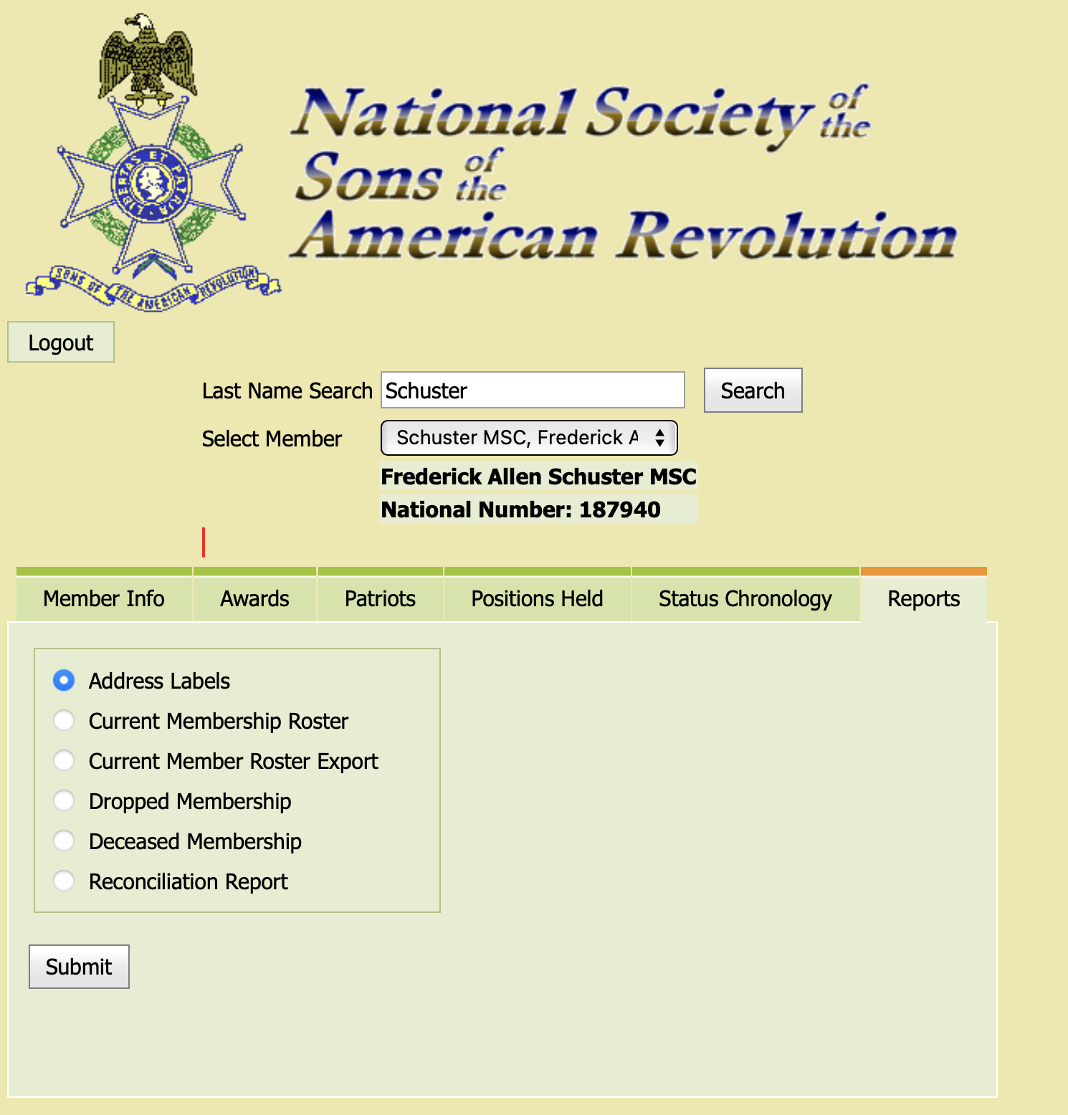
Other Useful Information
When you are in the Yellow Data Base, you can run different types of reports.
Address Labels
Chapter Current Roster by date
Can Export your Roster in Excel format
Run a Reconciliation Report of:
New Members
Deceased Members
Transfers
Junior Members

Slide 18
Year End Reports
The CASSAR bylaws and Article of Incorporation have specific information which must be reported each year to the CASSAR governing board.
The CASSAR Secretary has published an example of a Chapter Year End Annual Report which has all of the information which needs to be reported to the state.
The reports need to be submitted to the CASSAR between March 1st and March 15th of each year.
The reports need to include the Tax Information for the Chapters.

Slide 19
The CASSAR bylaws and Article of Incorporation require that each chapter file their taxes.
The bylaws require that the chapters report in their annual report that the taxes were filed.
Each chapter must submit a copy of the tax forms with the CASSAR Compliance Officer, Luke Dziurzynski; email- lukaszad@gmail.com
There are four forms that need to be filed each year.
form 990N
form 199N
form CT-TR-1
form RRF-1
Each Chapter must File their Taxes every year.
Send Luke a copy of your e-post card of the filing.

Slide 20
Questions
Call me if you help with any issues; (909) 985-7510

