Slide 1

California Society
Secretary Forum
Transfers, Dual Members, & Reinstatements
November 18, 2020

Slide 2
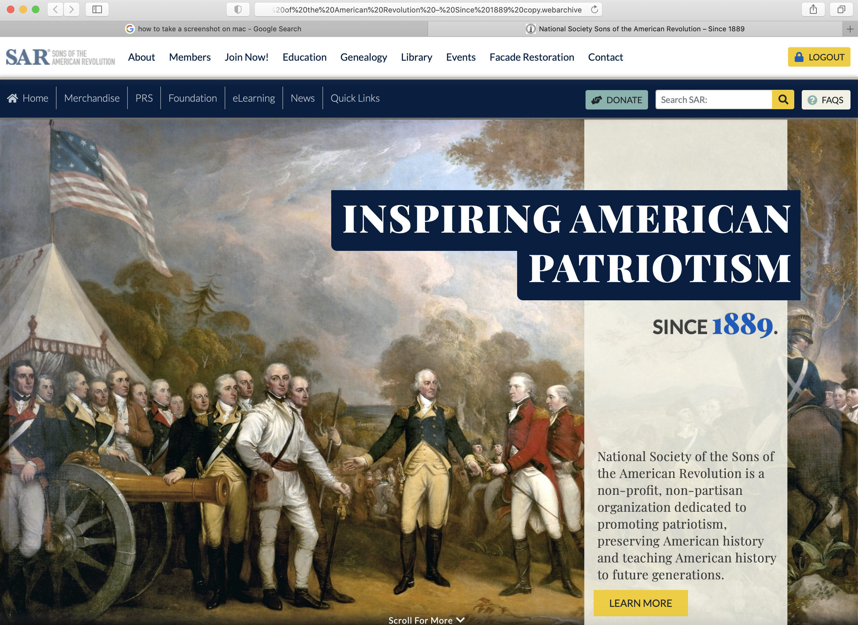
Where do I
Find
Where do I
Find the
Forms
Log into the National Web Site.
At the top of the page is a White Tool Bar.
Look For the “Members” tab.
There will be drop down, go to ”Forms & Manuals.”
Scroll down to the middle of the forms to the the “Organizational Forms” section.
In this section you will find most of the forms that are used by the chapter secretary in a PDF printable format.

Slide 3
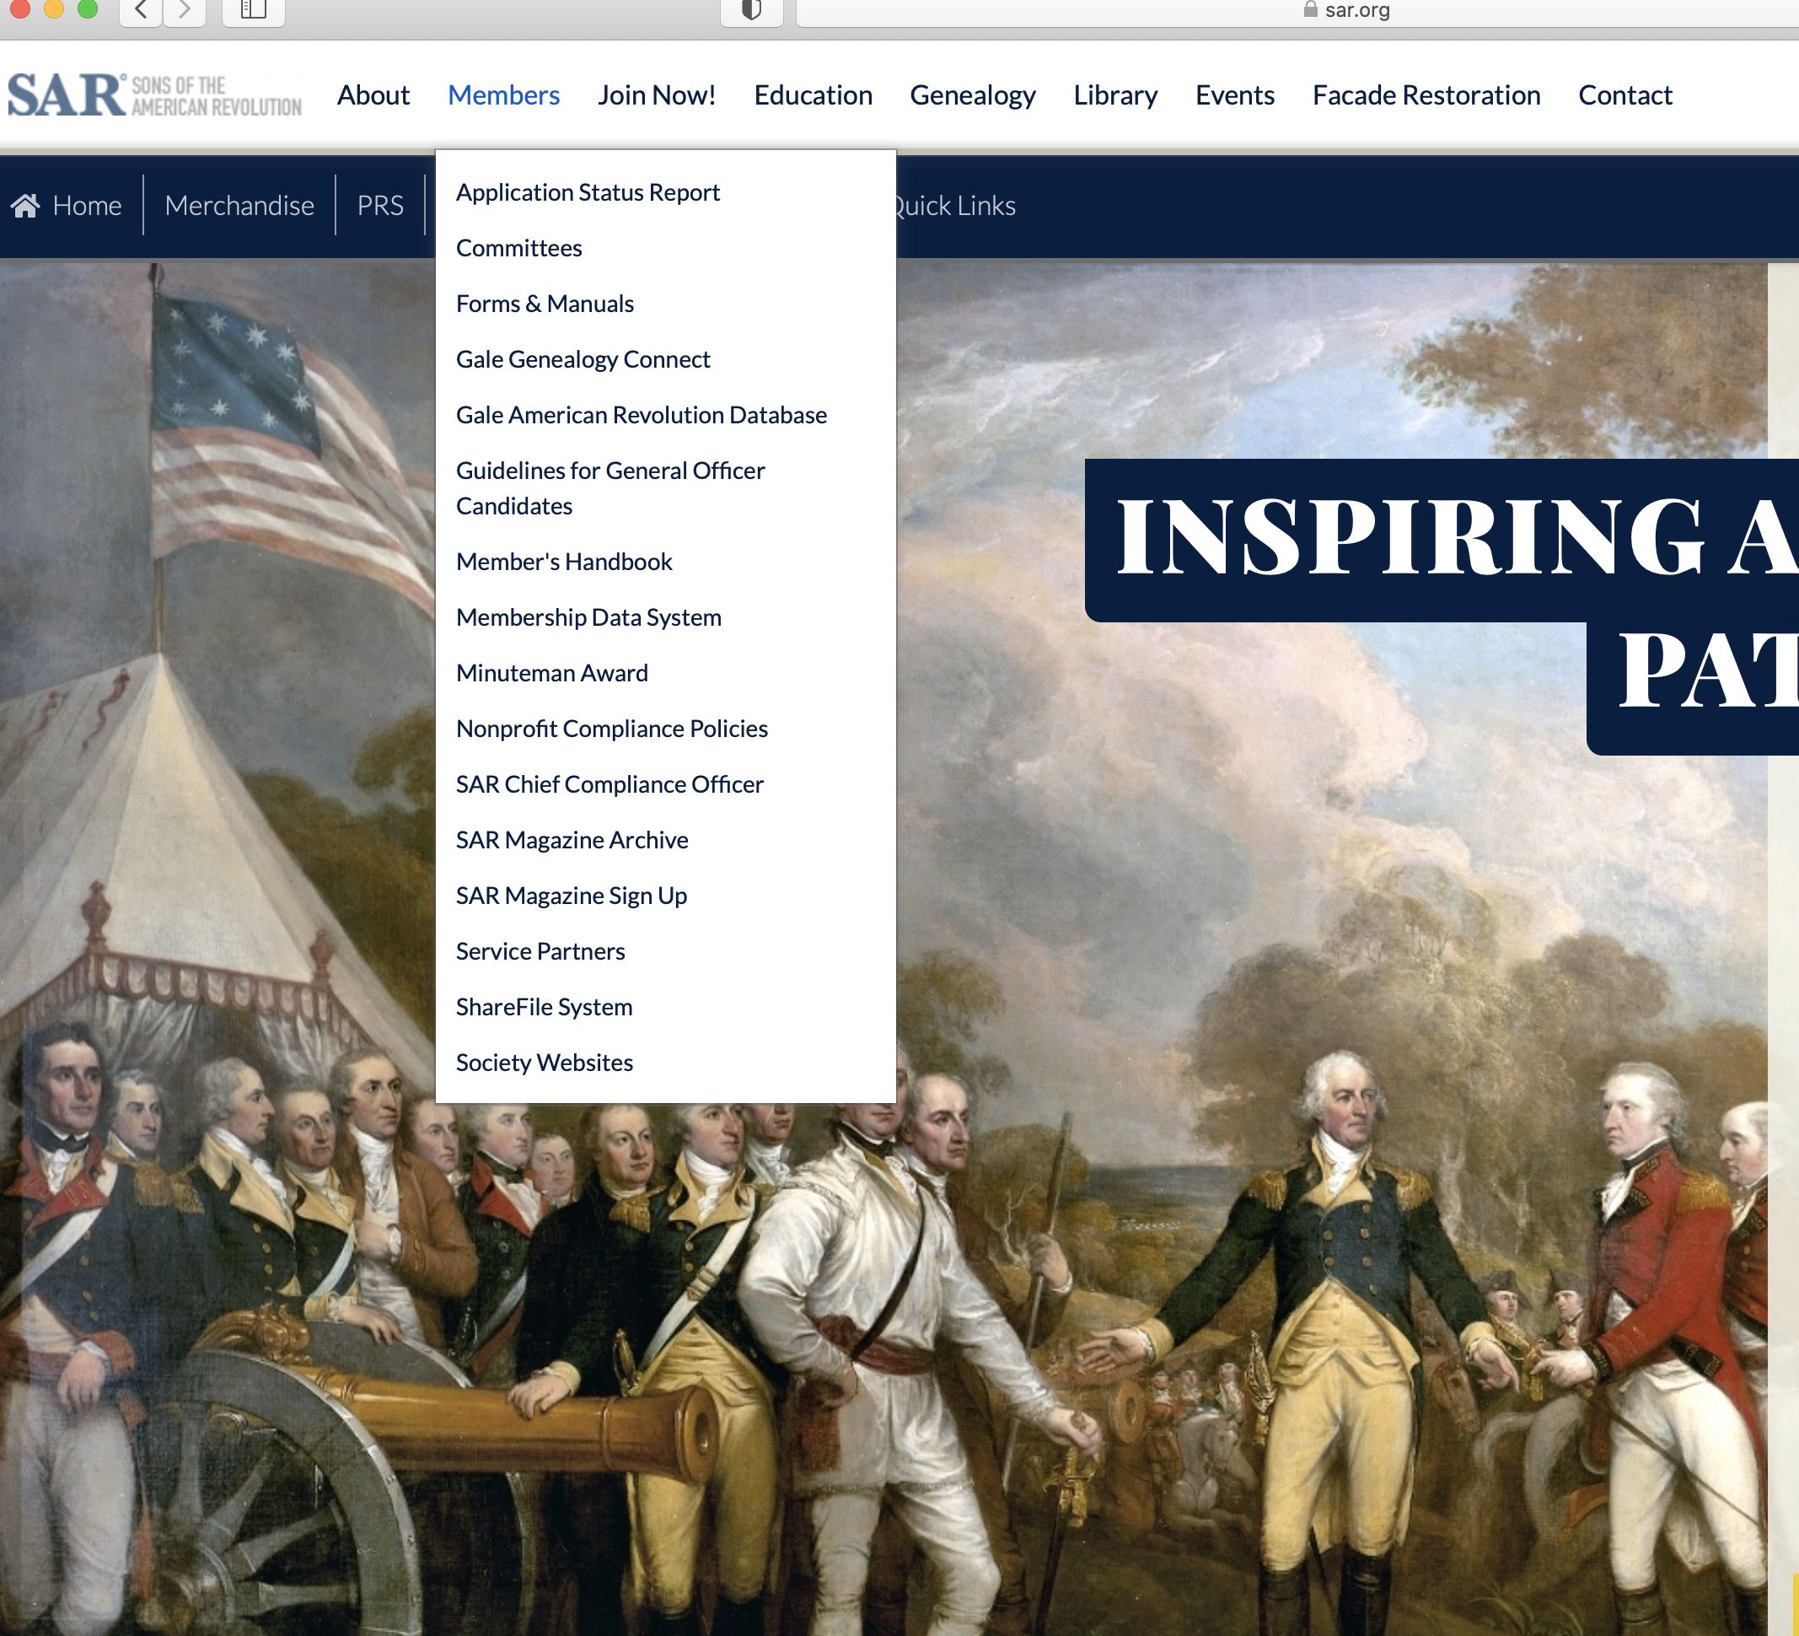
Where do I
Find the
Forms
Log into the National Web Site.
At the top of the page is a White Tool Bar.
Look For the “Members” tab.
There will be drop down, go to ”Forms & Manuals.”
Scroll down to the middle of the forms to the the “Organizational Forms” section.
In this section you will find most of the forms that are used by the chapter secretary in a PDF printable format.

Slide 4
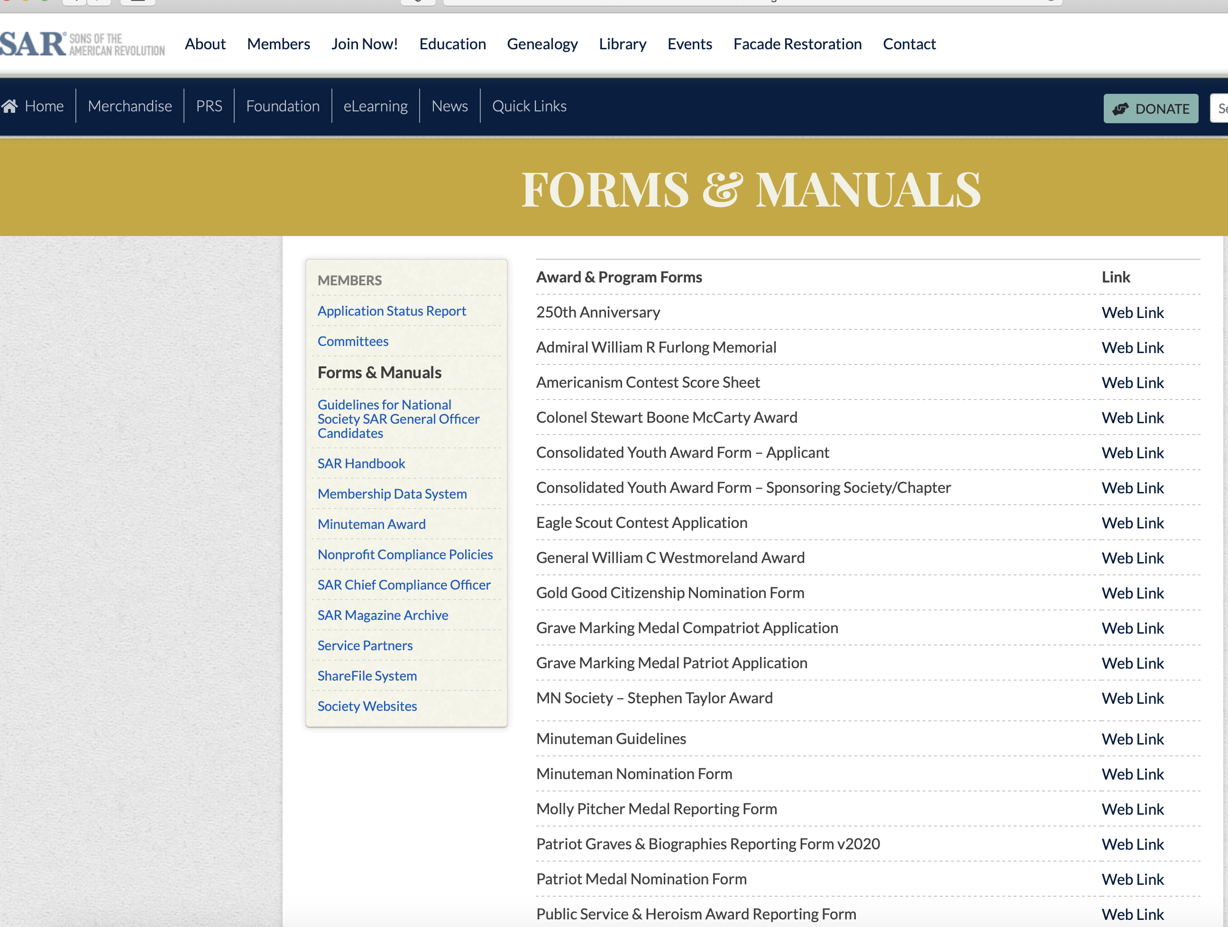
Where do I
Find the
Forms
Log into the National Web Site.
At the top of the page is a White Tool Bar.
Look For the “Members” tab.
There will be drop down, go to ”Forms & Manuals.”
Scroll down to the middle of the Forms to the the “Organizational Forms” section.
In this section you will find most of the forms that are used by the chapter secretary in a PDF printable format.

Slide 5
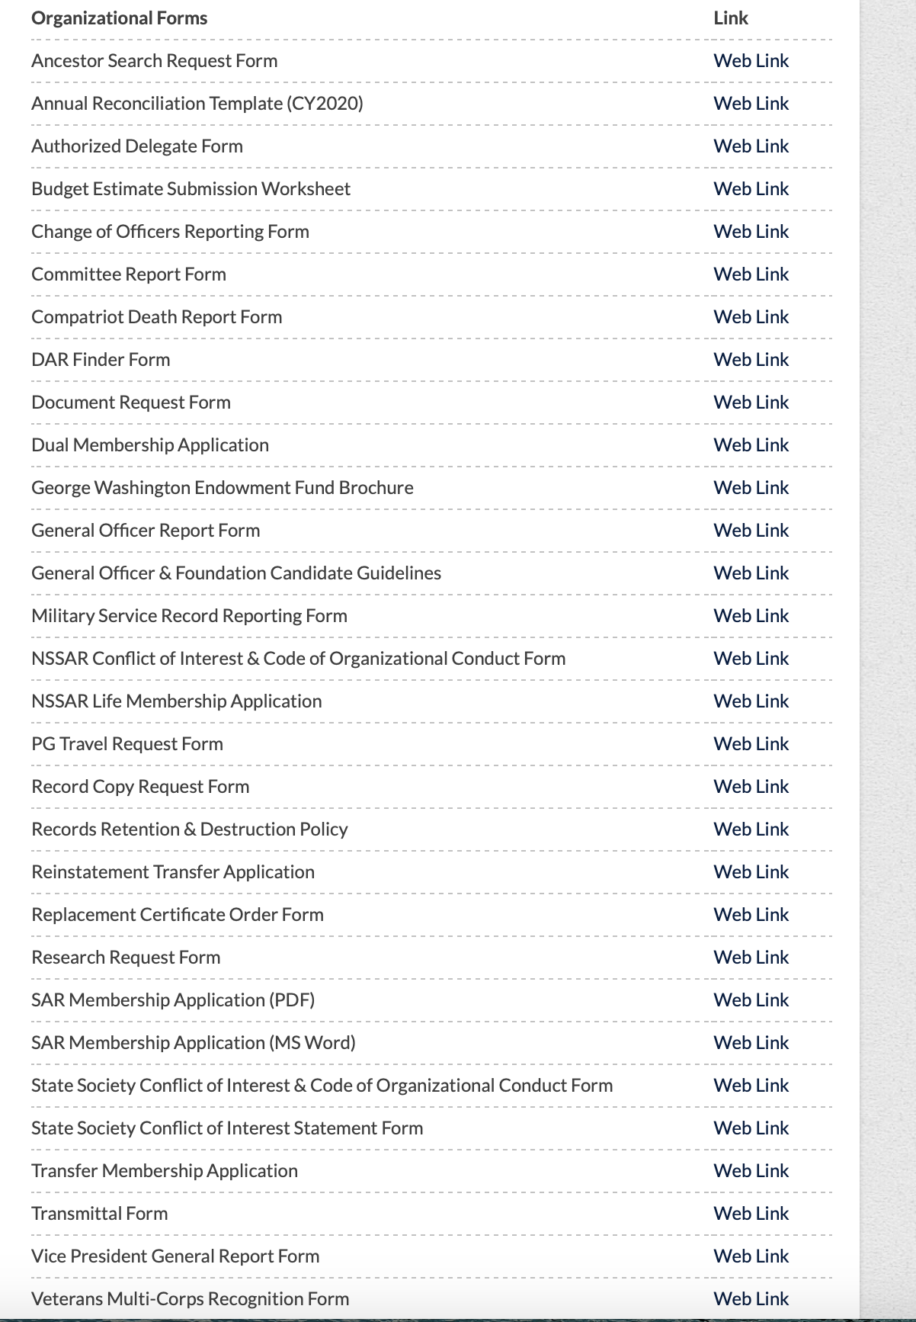

Where do I
Find the
Forms
Log into the National Web Site.
At the top of the page is a White Tool Bar.
Look For the “Members” tab.
There will be drop down, go to ”Forms & Manuals.”
Scroll down to the middle of the forms to the the “Organizational Forms” section.
In this section you will find most of the forms that are used by the chapter secretary in a PDF printable format.

Slide 6
Information on the Form
On the left side is the name of the form.
On the right side is the link to the form.
Click on the link to the form and the form will open in a format that can be typed on with the information that you need to enter.
The form can be saved in the same manner that you would save any word form onto your computer and you can print the form directly from this site.

Slide 7
Where do I
Find the
Forms
COMMON FORMS
Compatriot Death Reporting Form
DAR Finder Form
Dual Membership Application Form
NSSAR Life Membership Application
Record Copy Request Form
Reinstatement Transfer Application Form*
Transfer Membership Application Form*
Replacement Certificate Order Form
Log into the National Web Site.
At the top of the page is a White Tool Bar.
Look For the “Members” tab.
There will be drop down, go to ”Forms & Manuals.”
Scroll down to the middle of the forms to the the “Organizational Forms” section.
In this section you will find most of the forms that are used by the chapter secretary in a PDF printable format.

Slide 8
Transfer Forms
Often the first point of contact is the chapter secretary when a member wants to transfer their membership into the California Society.
The member should be directed back to his primary state secretary to begin the process of transferring his membership into the California Society. The form that needs to be used is form 0919 and not form 0918.
Form 0919 is the correct form for the transfer of membership into and out of the California Society, if a member uses Form 0918 it will delay his transfer.
The California Society Requires that all members transferring into the state must submit a Record Copy with their application. The application will not be completed until a Record Copy has been received.

Slide 9
Application for Transfer of Membership
(1) The form has three sections
(2) Section one the member needs to fill out and sign.
(3) Section two is for the Demitting State Secretary to fill out and sign.
(4)Section three is for the receiving State Secretary to fill out and sign
(5) The receiving state must complete the transaction by filing the paperwork with National.
(6) California requires that all transfers submit a copy of their Record Copy with their Application.

Slide 10
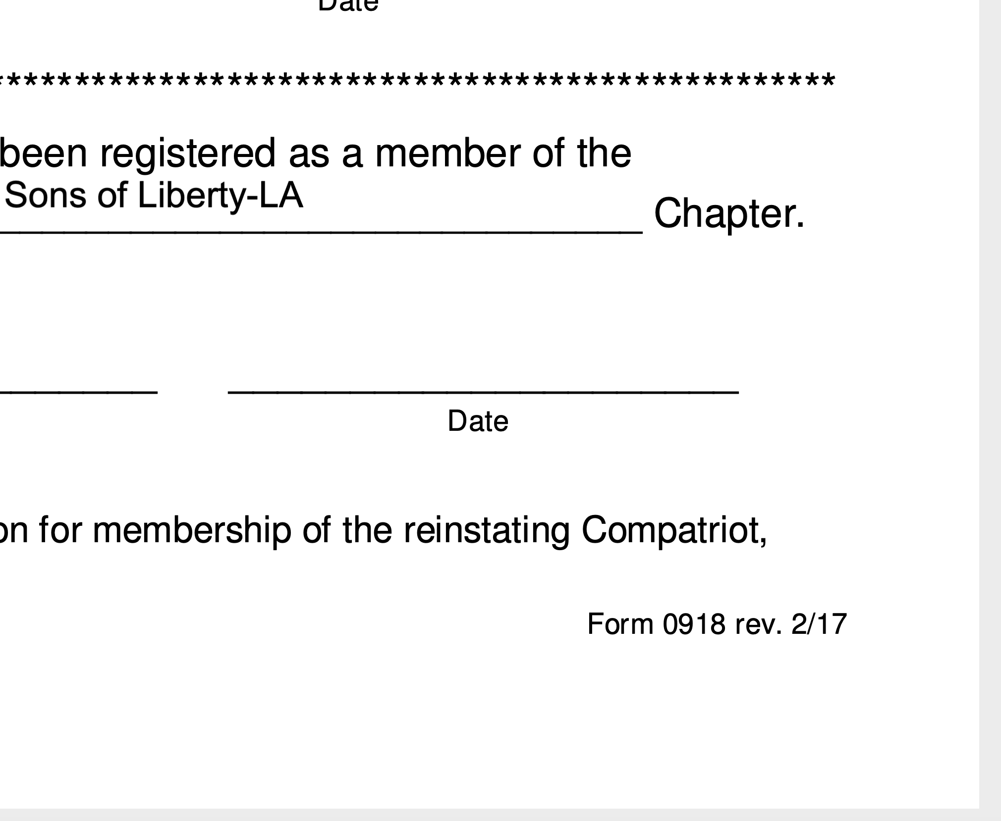
Where to find the
form number.

Slide 11
Chapter to Chapter Transfers
Many members have decided to transfer their membership from their original chapter to another chapter, with out informing the the original chapter.
When this is done, a member will be dropped from the California and National Roster for non-payment of dues because his status was not changed in the National Data base and the original chapter listed him as a drop.
There is no number, a CASSAR Document

Slide 12
Application to Reinstate Membership into the California Society
(1) This Form 0918 and should not be used for the transfer of membership.
(2) The California Society By-laws require that the Sate Secretary obtains the approval of the Executive Committee prior to any reinstatement of membership.
(3) This is a three part document, part one the member fills out, part two the state secretary, and part three NSSAR.
(4) It can take up to six weeks for a member to be reinstated.

Slide 13
Comparison of the two Forms
Application for Transfer of Membership into or out of a state society.
Application for reinstatement into the California Society.

Slide 14
Dual State Membership
National has a form 0920 which is meant for members that desire to be a ”Dual” member in another state to fill out each year and file with the State Secretary.
Form 0920 affirms that that the member is in good standing with his current state and has paid his dues to NSSAR.
The California Society requires that all Dual state members members provide a Record Copy to the state and that a state number is issued, since the member pays the California State Society dues.

Slide 15
Dual State Membership
Chapters should request that their Dual State member provide the state with this Form, there are a few exceptions, when the dual member is also a California State Life Members.
Chapters need to collect California State dues from State Dual members and list them on the annual Reconciliation Report.

Slide 16
Find the
Forms on the
S. NSSAR Site
Remember
Log into the National Web Site.
At the top of the page is a White Tool Bar.
Look For the “Members” tab.
There will be drop down, go to ”Forms & Manuals.”
Scroll down to the middle of the forms to the the “Organizational Forms” section.
In this section you will find most of the common forms that are used by the chapter secretary in a PDF printable format.

Slide 17
Questions

